Slide 1
NYC Restaurants
Mina Bansal
Alex Burschtin
Denise Person
Mayobanex Martinez

Slide 2
Theme
We are creating a restaurant resource to find restaurants in NYC
You can filter by category, price, and rating
Notes:
The Yelp API will be used for data gathering. After gathering over 100 restaurants/bars/breweries we will create a MongoDB database that will store several data points per restaurant:
“name”
“address1"
“latitude”
“longitude”
“rating”
“review_count”
“price”
“phone”
We will most likely focus on lower manhattan and brooklyn to narrrow the scope of the dashboard/map. This will enable us to gain deeper insight into those corresponding neighborhoods vs less research if we had a larger scope. We will include a Python Flask–powered RESTful API, HTML/CSS, JavaScript, and at least one database (SQL, MongoDB, SQLite, etc.).
We will probably have 2 sets of drop downs to help the user narrow their search on our application (WIP):
1st (Location type): Restaurant, Bar, Brewery/Craft Beer Store
2nd (Yelp $): $, $$, $$$, $$$$
Visualization plan - stretch goal is something similar to the infatuation map website where you can filter for the above parameters/drop down to find a restaurant/bar.

Slide 3
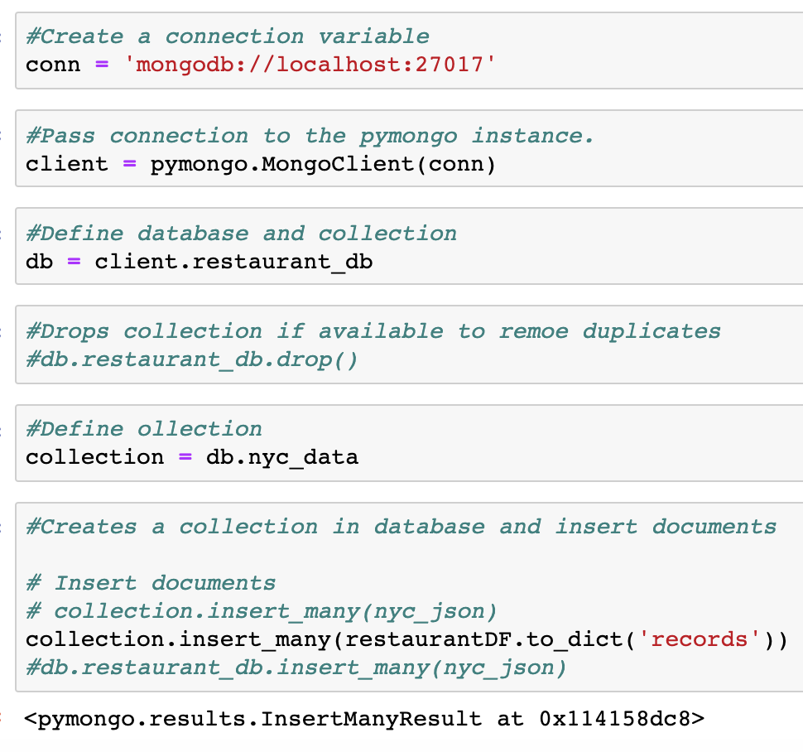
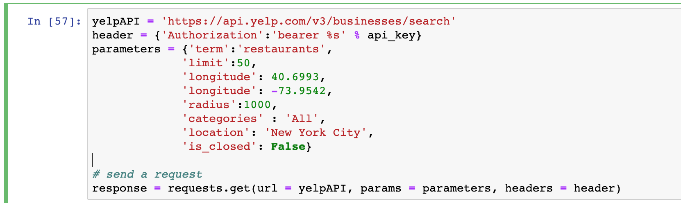
Coding Approach
Python - pull data from Yelp API
Mongo - store data
Flask - server, access data
Notes:
Data Monging

Slide 4
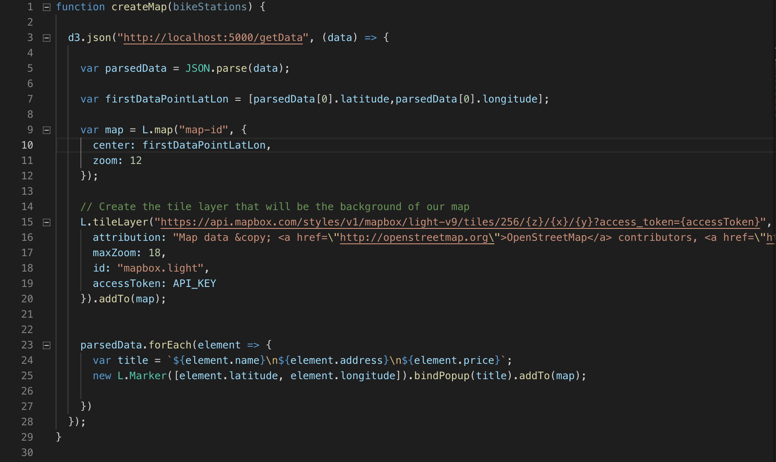
Javascript / Front-End
Javascript - create interactive map
HTML/CSS - create website

Slide 5

Next steps
Make API request for all neighborhoods
Javascript
Popper
Deploy website
Notes:
Data Monging

Slide 6
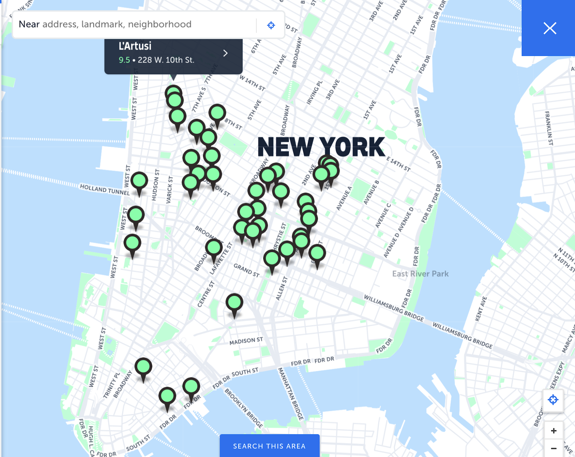
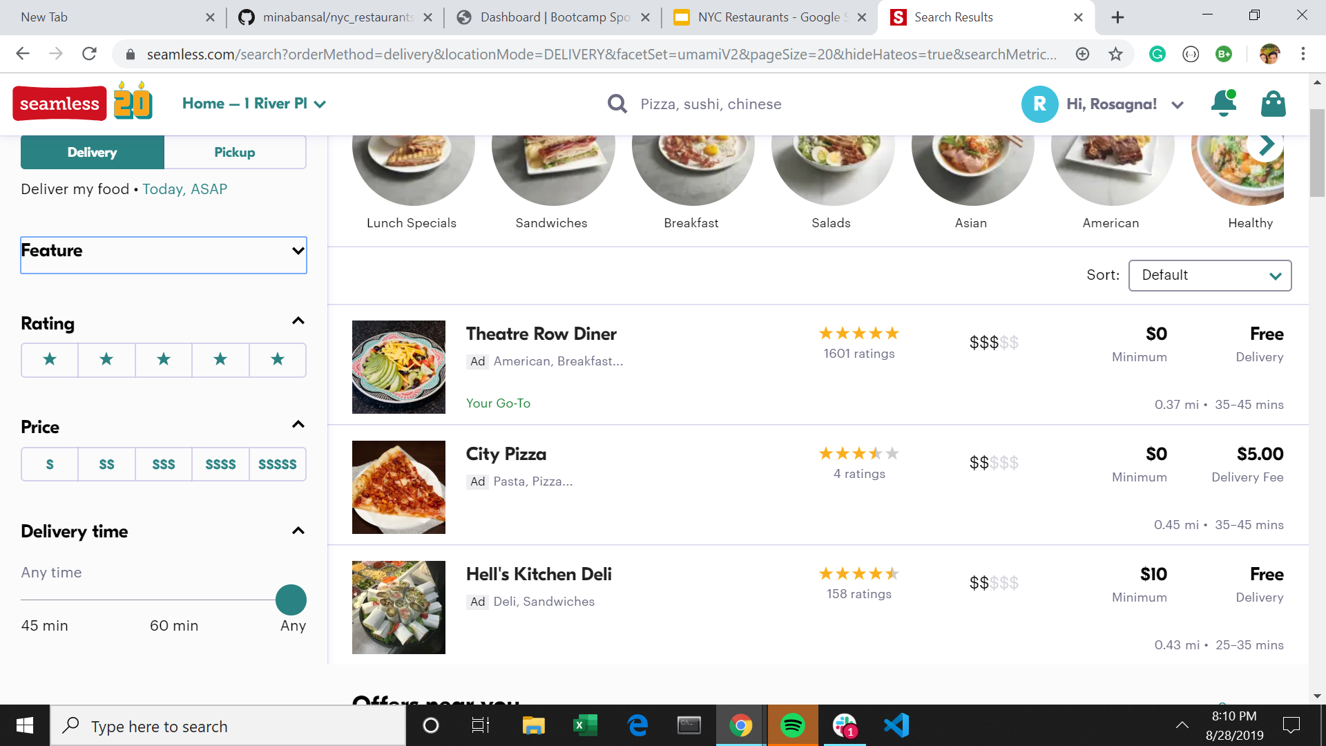
Vision
“Name”
“Latitude”
“Longitude”
“Rating”
“Review_count”
“Price”
Location

